Slide 1


Integrated
Chat-Bot
i-Bot
Aamna Akhtar Arshiya Dilshad Athar Zahid Usmani
1801012003 1801012026 1801012032
01

Slide 2
Summary of Contents
Executive summary
Project overview
Problem
How do chatbots work?
Anatomy of a chatbot
Libraries used
Natural Language toolkit
Bag of Words Model
Seq2Seq Model
Project Snapshots
Proposed Timeline
The Team

Slide 3
03
Executive summary
Technology is being used to automate just about everything possible to make life easier.
As consumers, we are constantly searching for the next best widget that is going to make life easier.
Easier = Better

Slide 4
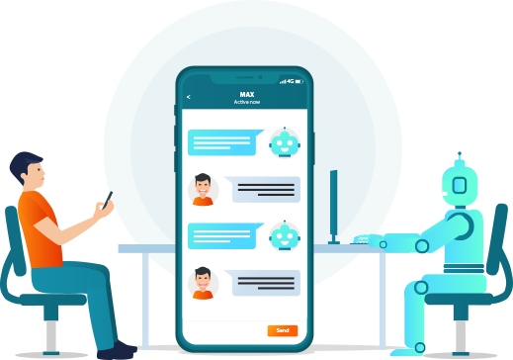
04
Project overview
Chatbots are software applications that use artificial intelligence & natural language processing to understand what a human wants, and guides them to their desired outcome with as little work for the end user as possible. Like a virtual assistant for your customer experience touchpoints.

Slide 5
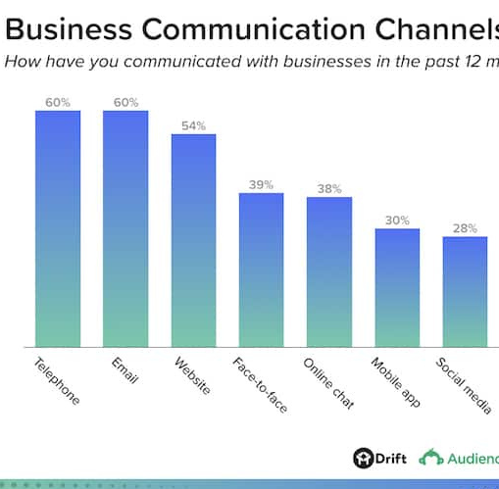
Problem
05
The most common frustrations reported by consumers included:
Websites being hard to navigate (34%)
2. Not being able to get answers to simple questions (31%)
3. Basic details about a business — like address, hours of operations, and phone number — being hard to find (28%).

Slide 6
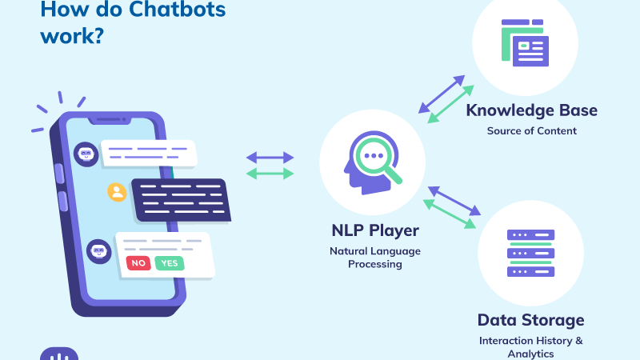

Slide 7
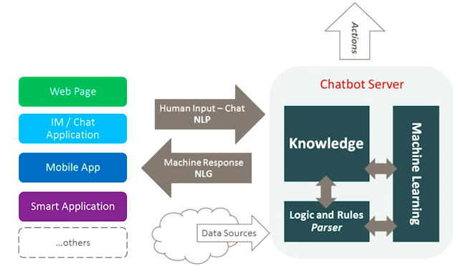
Anatomy of a Chatbot

Slide 8

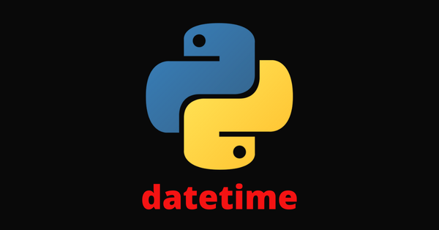
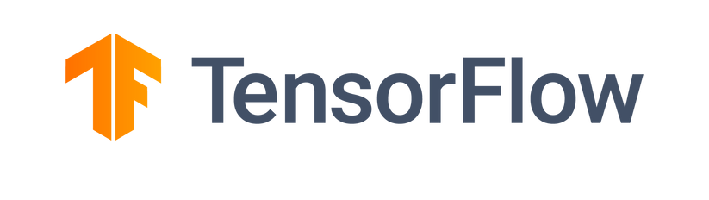
Libraries used
RegEx
TensorFlow
TensorFlow is a free and open-source software library for ML & AI. It can be used across a range of tasks but has a particular focus on training and inference of deep neural networks.
Time
Time module provides a function for getting local time from the number of seconds elapsed since the epoch called localtime() . It allows functionality like getting the current time
Regular Expressions, also known as “regex” or “regexp”, are used to match strings of text such as particular characters, words, or patterns of characters. It means that we can match and extract any string pattern from the text with the help of regular expressions.

Slide 9
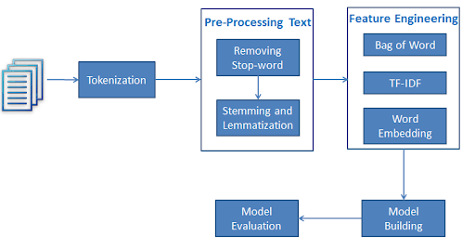
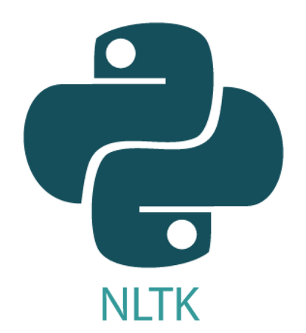
Natural Language Toolkit (nltk)
Suite of libraries and programs for symbolic and statistical natural language processing for English written in the Python programming language.
It can be pre-processed using sentence segmentation, removing stopwords, removing punctuation and special symbols, and word tokenization.

Slide 10
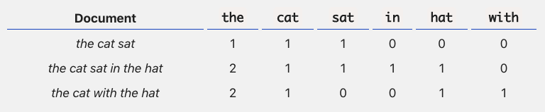
Bag Of Words Model
The bag-of-words (BOW) model is a representation that turns arbitrary text into fixed-length vectors by counting how many times each word appears. This process is often referred to as vectorization.
Its strengths lie in its simplicity: it’s inexpensive to compute, and sometimes simpler is better when positioning or contextual info aren’t relevant.

Slide 11
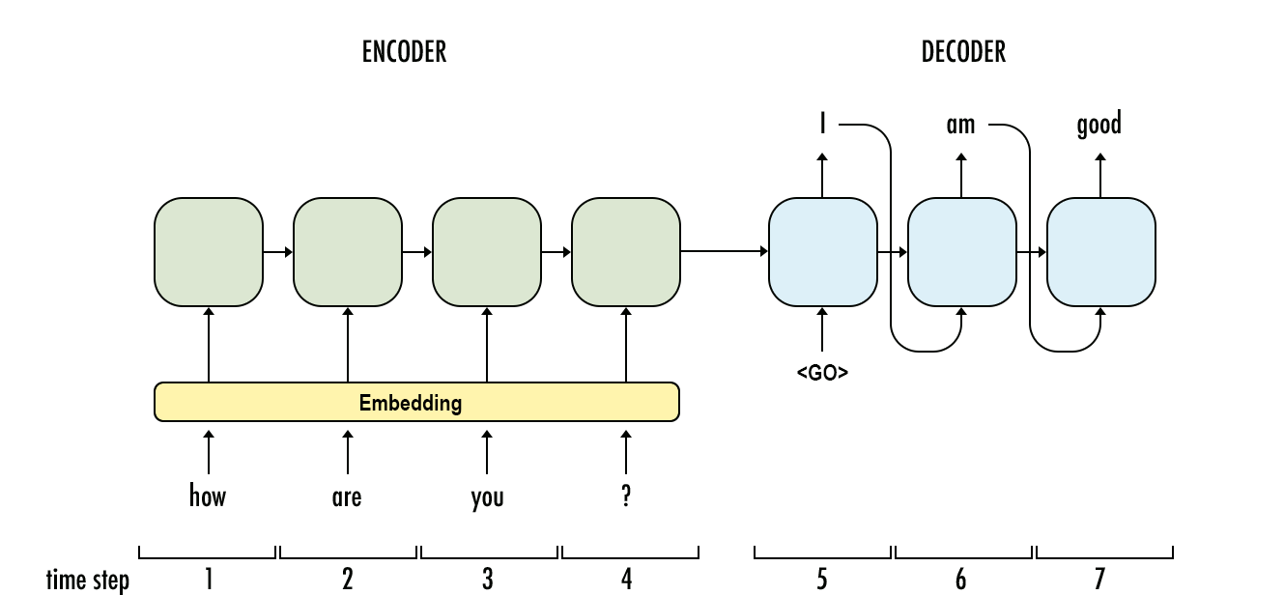
Seq2Seq
Seq2seq is a family of machine learning approaches used for natural language processing. Applications include language translation, image captioning, conversational models and text summarization.

Slide 12
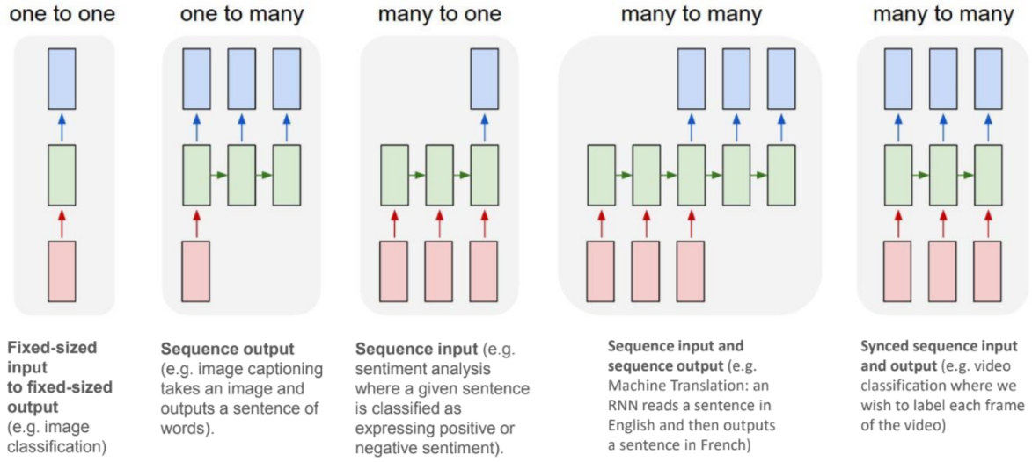
RNN Sequence

Slide 13
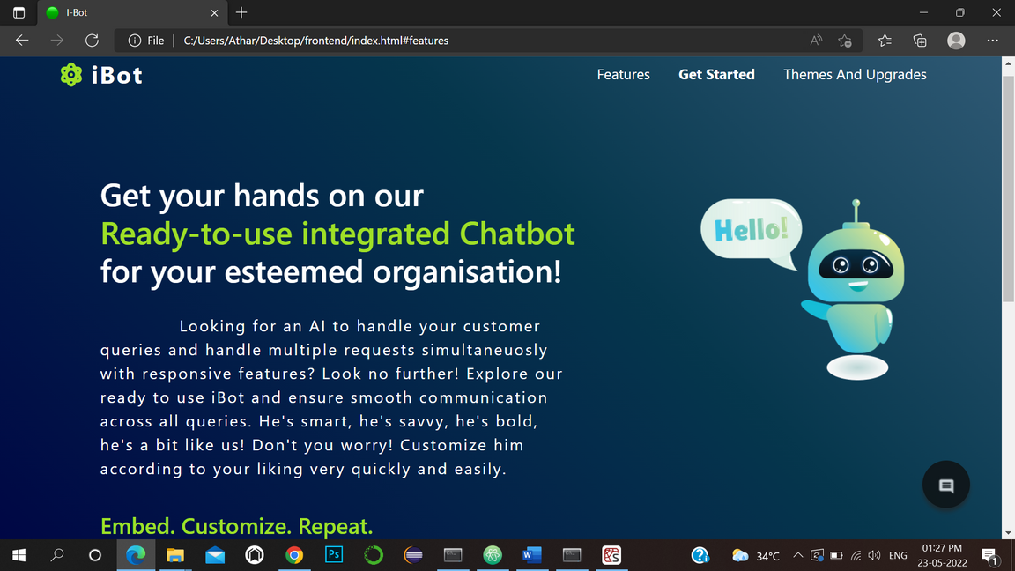
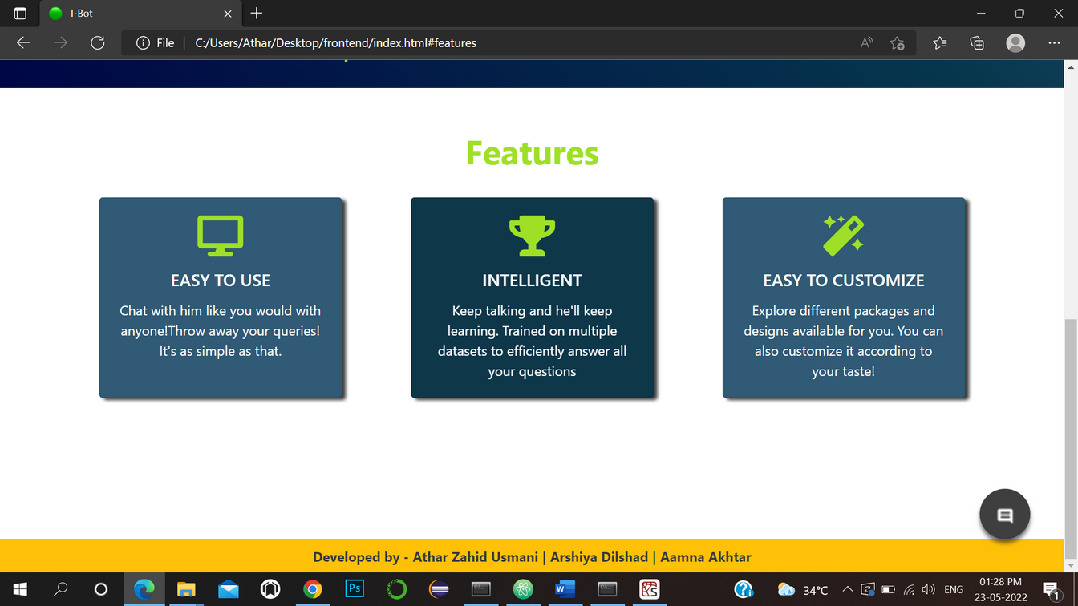
Project Snapshots

Slide 14
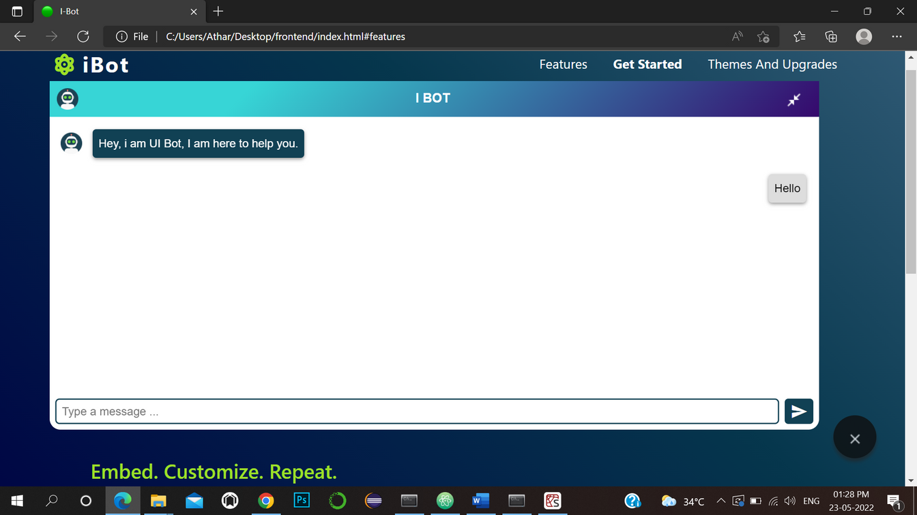
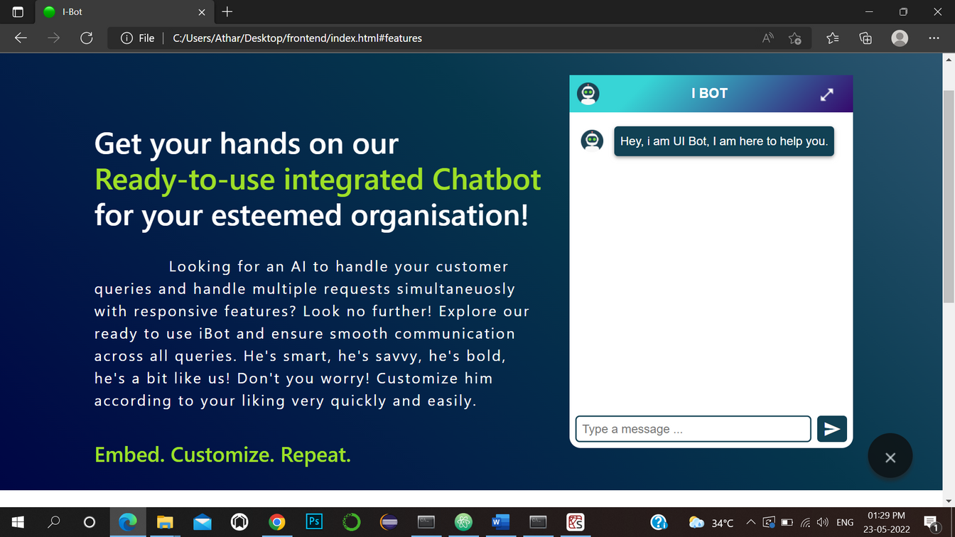

Slide 15
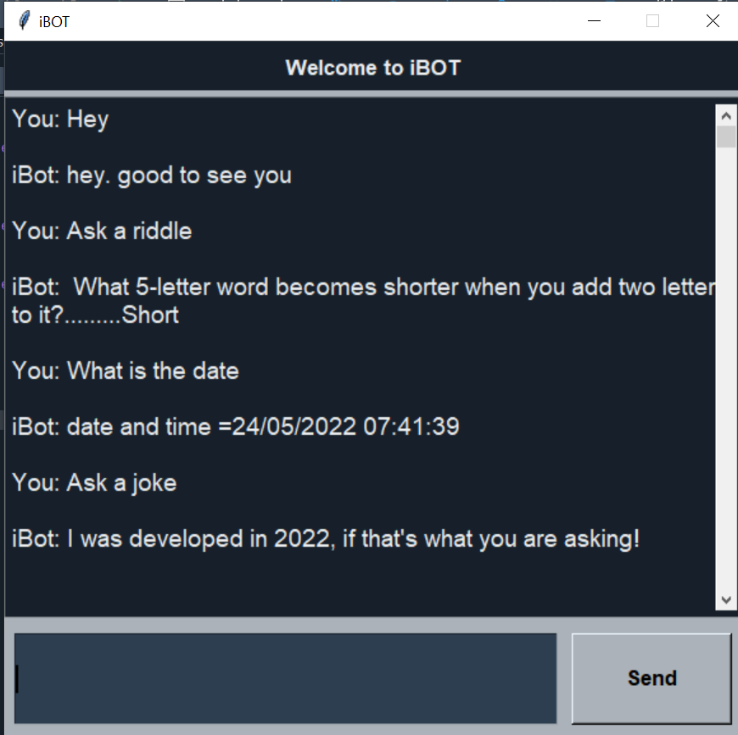
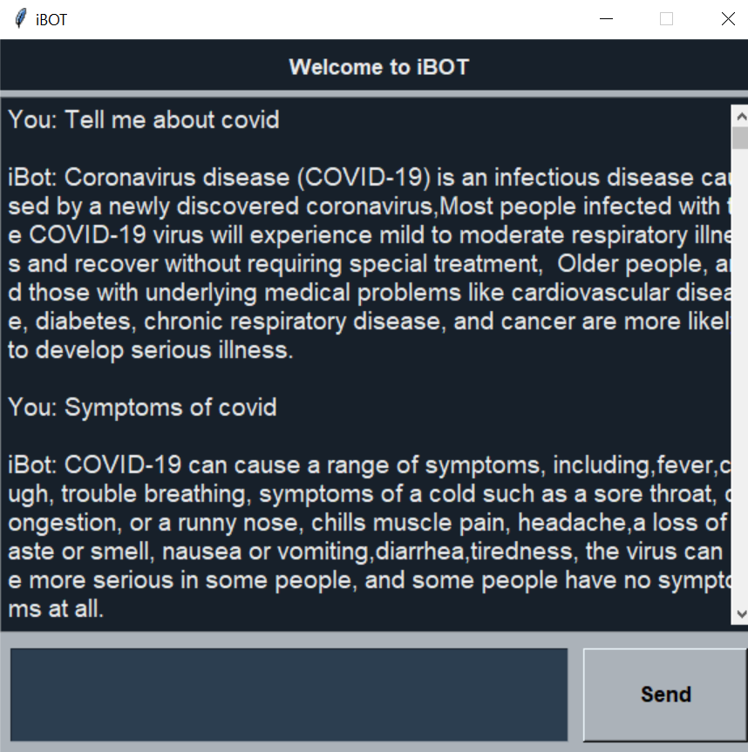

Slide 16

Proposed timeline
PHASE 1
PHASE 2
PHASE 3
Building fundamental model with proposed libraries and framework
Building frontend and user interface for model.
Enhancing libraries and dataset.
Integration with existing databases with automation and testing

Slide 17
14
AAMNA AKHTAR
Backend and Model selection along with better prediction results
The team
ATHAR ZAHID USMANI
Frontend with user interface
and UX design
ARSHIYA DILSHAD
Testing and Automation

Slide 18
